Slide 1
I/O Systems

Slide 2
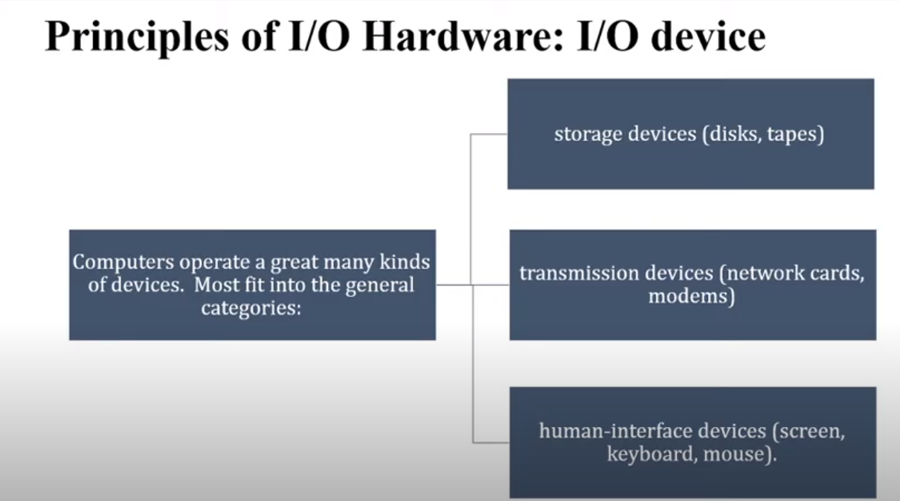

Slide 3
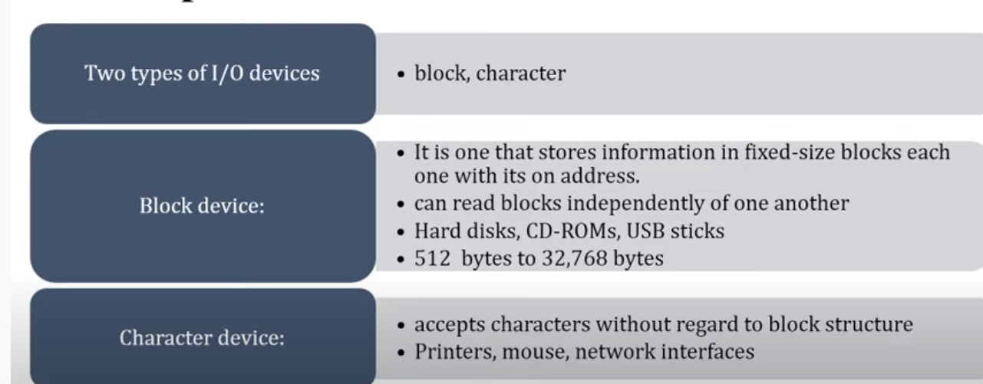

Slide 4
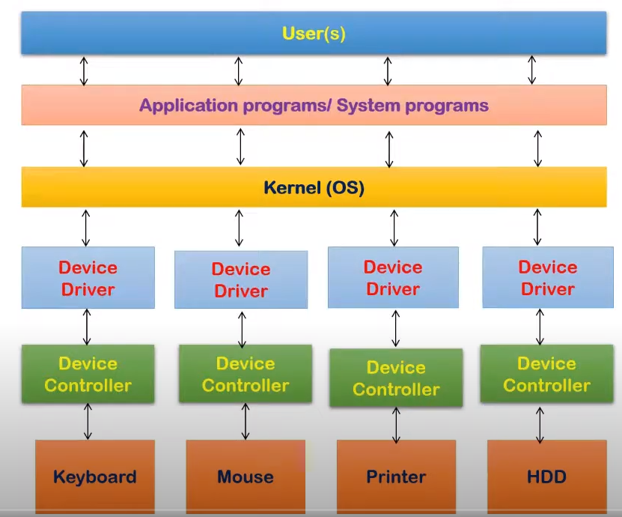

Slide 5
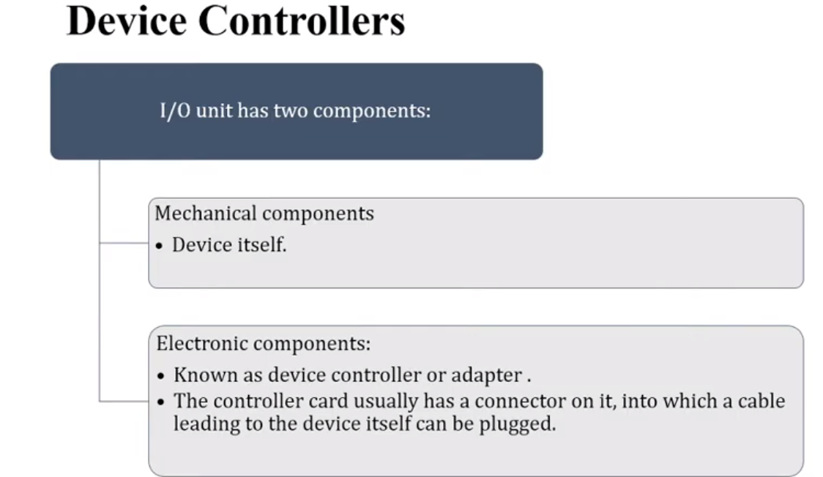

Slide 6
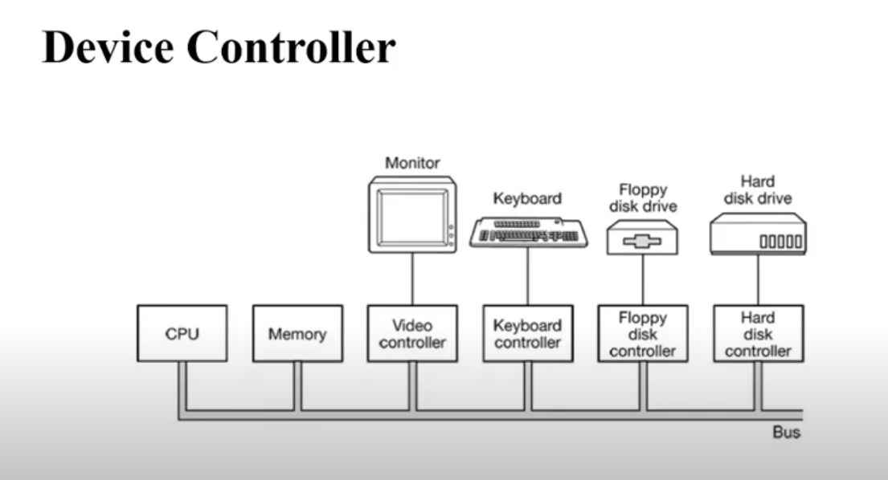

Slide 7
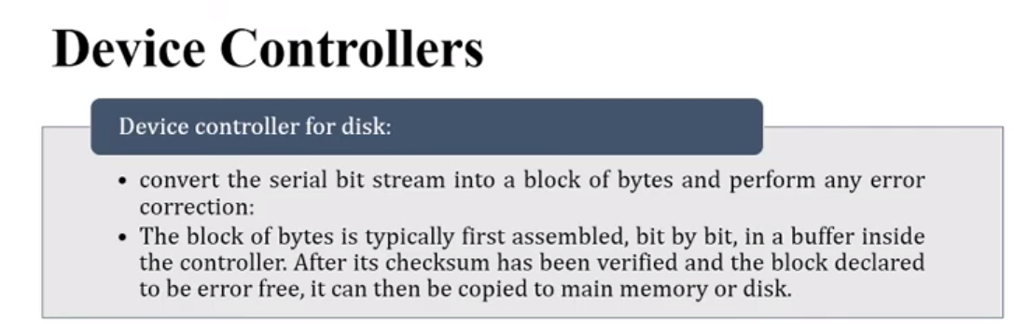

Slide 8
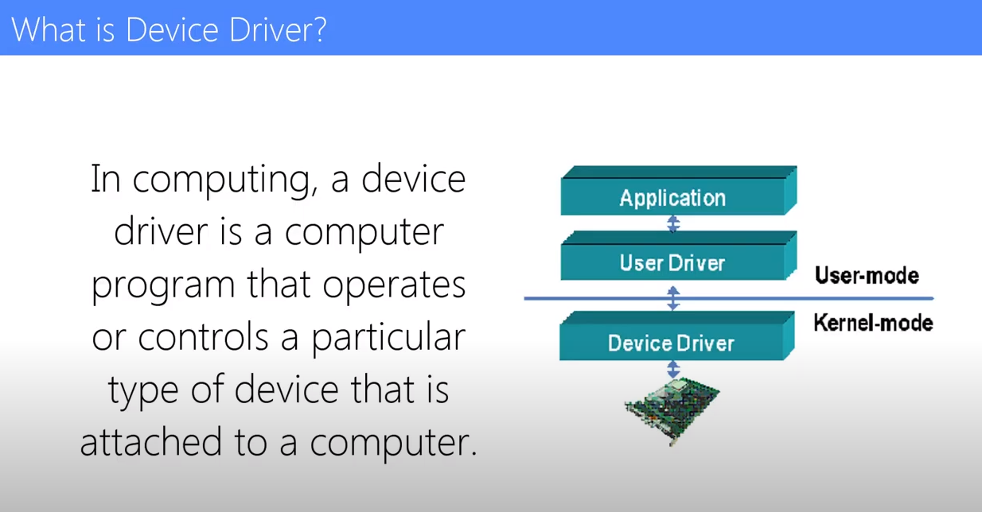

Slide 9
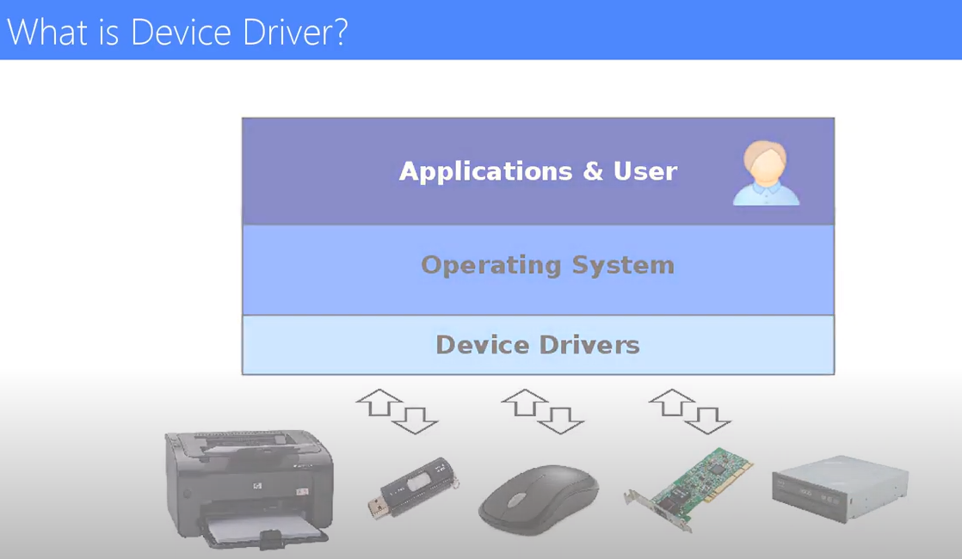

Slide 10
Overview
I/O management is a major component of operating system design and operation
  Important aspect of computer operation
  I/O devices vary greatly
  Various methods to control them
  Performance management
  New types of devices frequent
Ports, busses, device controllers connect to various devices
Device drivers encapsulate device details
  Present uniform device-access interface to I/O subsystem

Slide 11
I/O Hardware
Incredible variety of I/O devices
  Storage
  Transmission
  Human-interface
Common concepts – signals from I/O devices interface with computer
  Port – connection point for device
  Bus - daisy chain or shared direct access
    PCI bus common in PCs and servers, PCI Express (PCIe)
    expansion bus connects relatively slow devices
  Controller (host adapter) – electronics that operate port, bus, device
    Sometimes integrated
    Sometimes separate circuit board (host adapter)
    Contains processor, microcode, private memory, bus controller, etc
      Some talk to per-device controller with bus controller, microcode, memory, etc

Slide 12
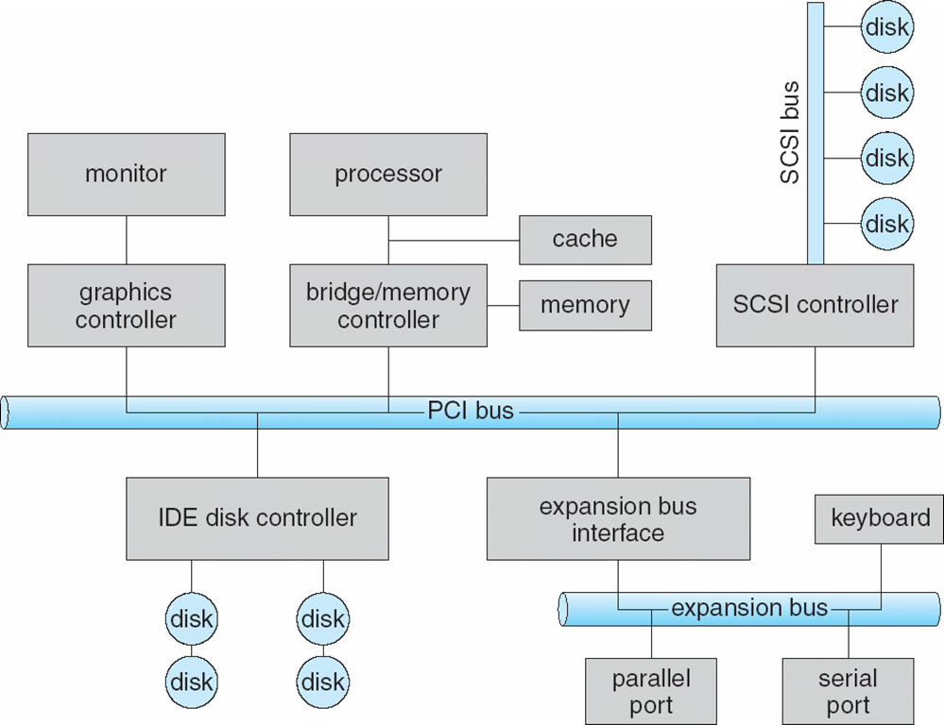
A Typical PC Bus Structure

Slide 13
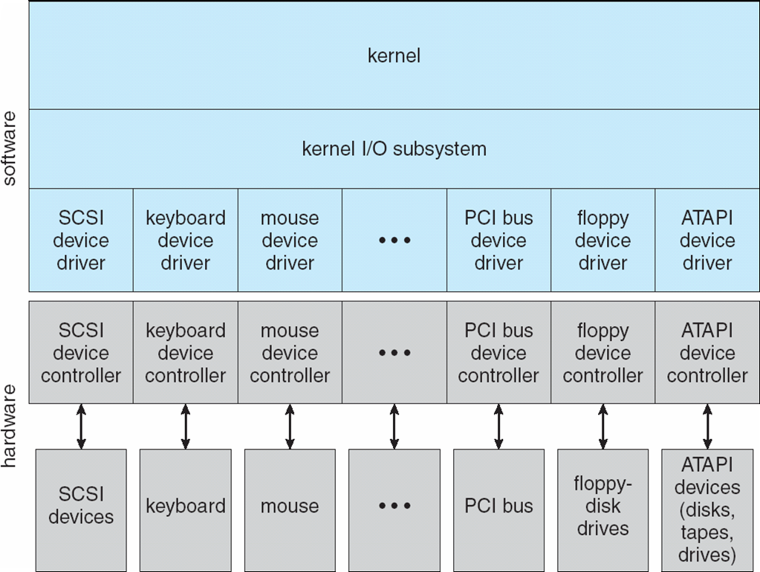
A Kernel I/O Structure

Slide 14
Block and Character Devices
Block devices include disk drives
  Commands include read, write, seek
  Raw I/O, direct I/O, or file-system access
  DMA
Character devices include keyboards, mice, serial ports
  Commands include get(), put()

Slide 15
Network Devices
Varying enough from block and character to have own interface
Linux, Unix, Windows and many others include socket interface
  Separates network protocol from network operation
  Includes select() functionality
Approaches vary widely (pipes, FIFOs, streams, queues, mailboxes)

Slide 16
Nonblocking and Asynchronous I/O
Blocking - process suspended until I/O completed
  Easy to use and understand
  Insufficient for some needs
Nonblocking - I/O call returns as much as available
  User interface, data copy (buffered I/O)
  Implemented via multi-threading
  Returns quickly with count of bytes read or written
  select() to find if data ready then read() or write() to transfer

Slide 17
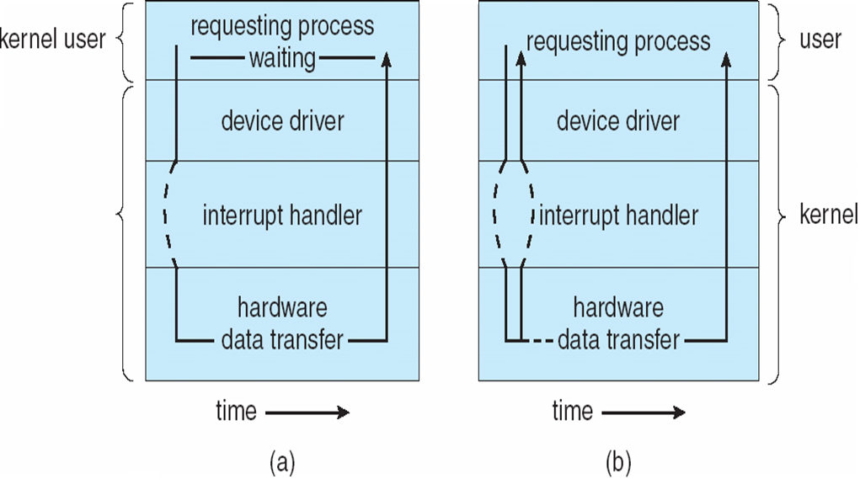
Two I/O Methods
Synchronous
Asynchronous

Slide 18
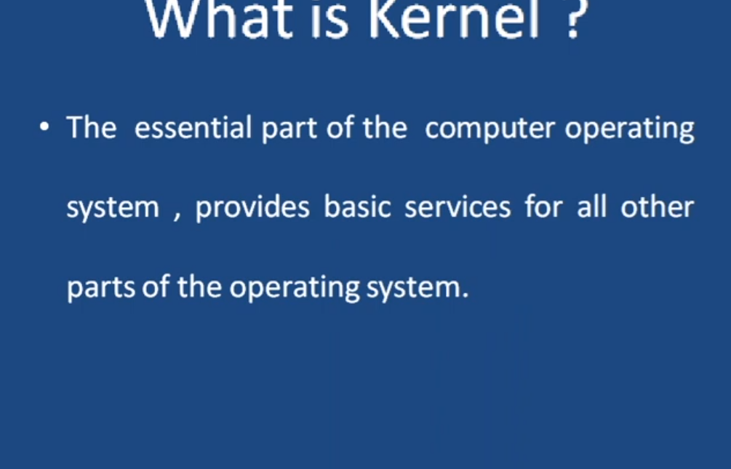

Slide 19
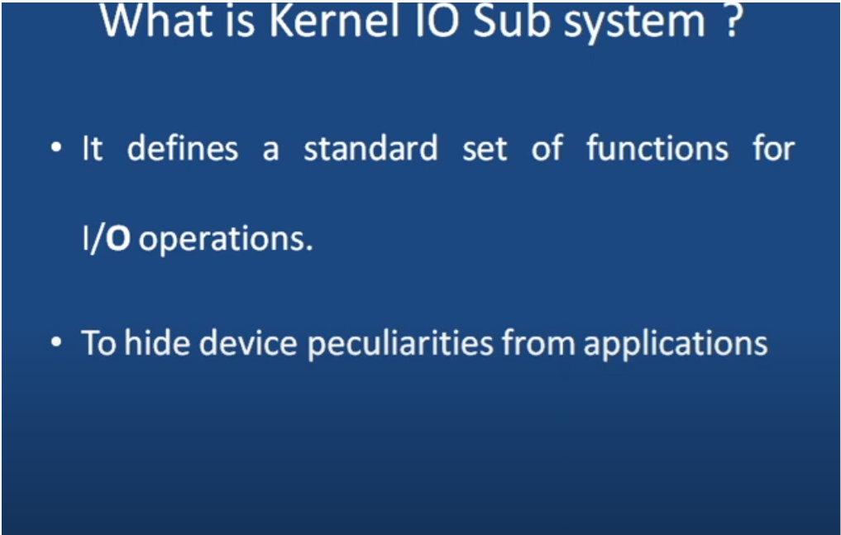

Slide 20
Kernel I/O Subsystem
Scheduling
  Some I/O request ordering via per-device queue
  Some OSs try fairness
  Some implement Quality Of Service (i.e. IPQOS)
Buffering - store data in memory while transferring between devices
  To cope with device speed mismatch
  To cope with device transfer size mismatch

Slide 21
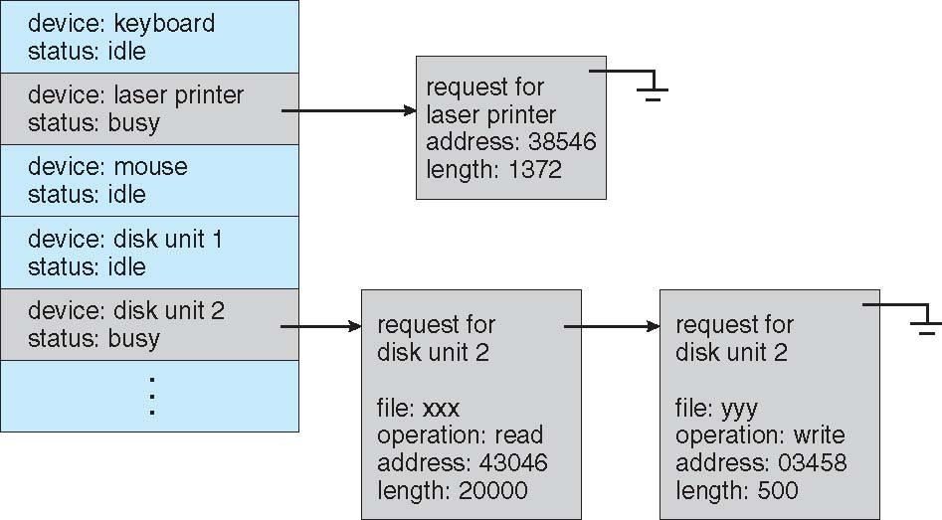
Device-status Table

Slide 22
Kernel I/O Subsystem
Caching - faster device holding copy of data
  Always just a copy
  Key to performance
  Sometimes combined with buffering
Spooling - hold output for a device
  If device can serve only one request at a time
  i.e., Printing
Device reservation - provides exclusive access to a device
  System calls for allocation and de-allocation
  Watch out for deadlock

Slide 23
Error Handling
OS can recover from disk read, device unavailable, transient write failures
Most return an error number or code when I/O request fails
System error logs hold problem reports

Slide 24
I/O Protection
User process may accidentally or purposefully attempt to disrupt normal operation via illegal I/O instructions
  All I/O instructions defined to be privileged
  I/O must be performed via system calls

Slide 25
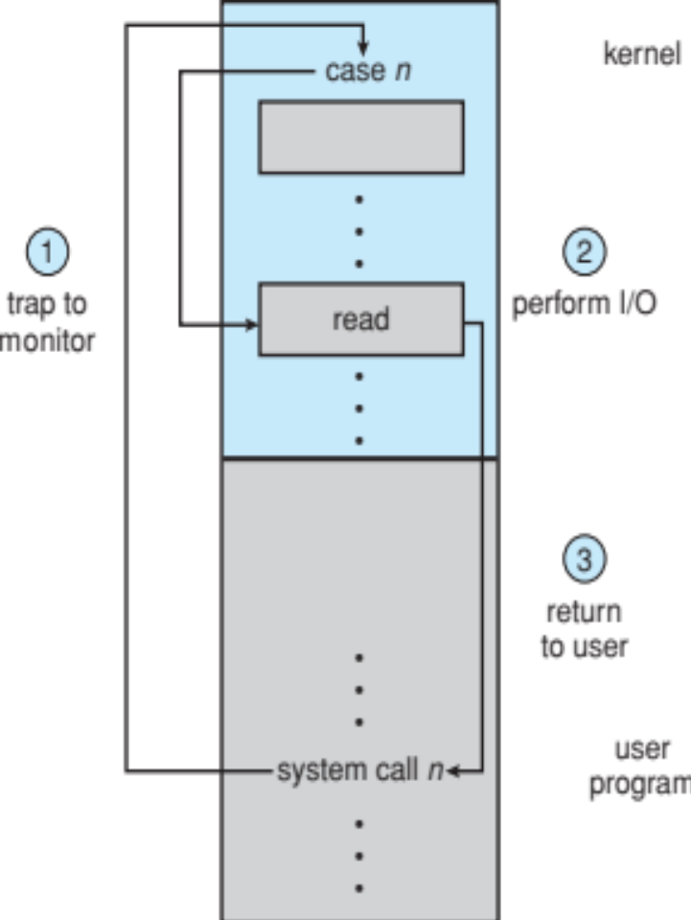
Use of a System Call to Perform I/O

Slide 26
Kernel Data Structures
Kernel keeps state info for I/O components, including open file tables, network connections, character device state
Many, many complex data structures to track buffers, memory allocation, “dirty” blocks
Some use object-oriented methods and message passing to implement I/O

Slide 27
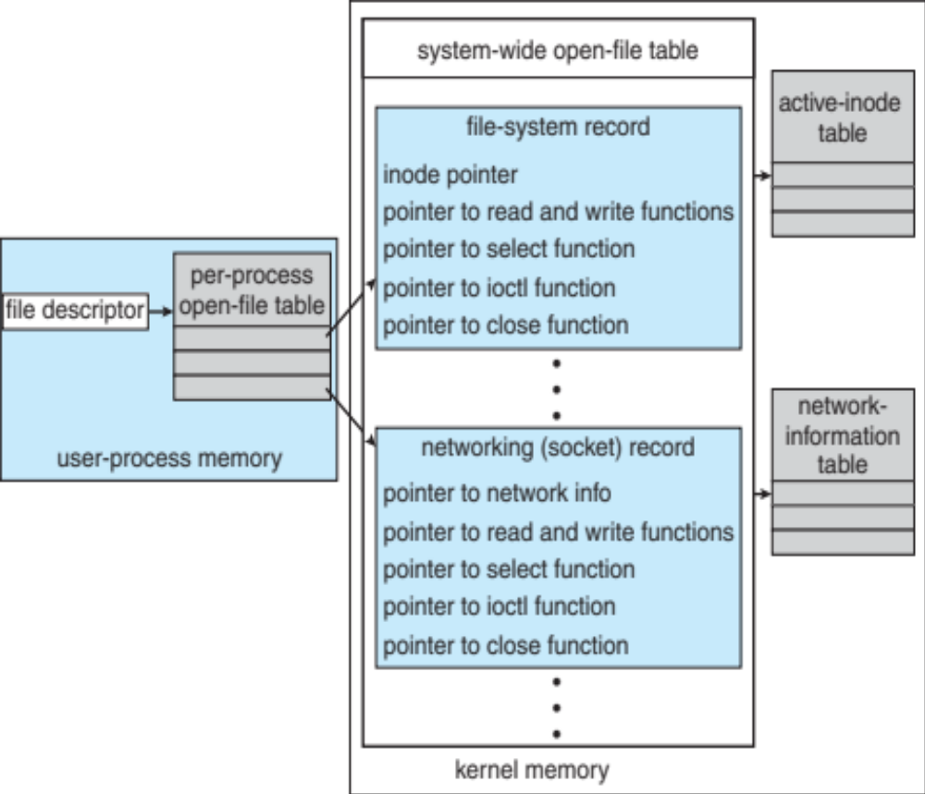
UNIX I/O Kernel Structure

Slide 28
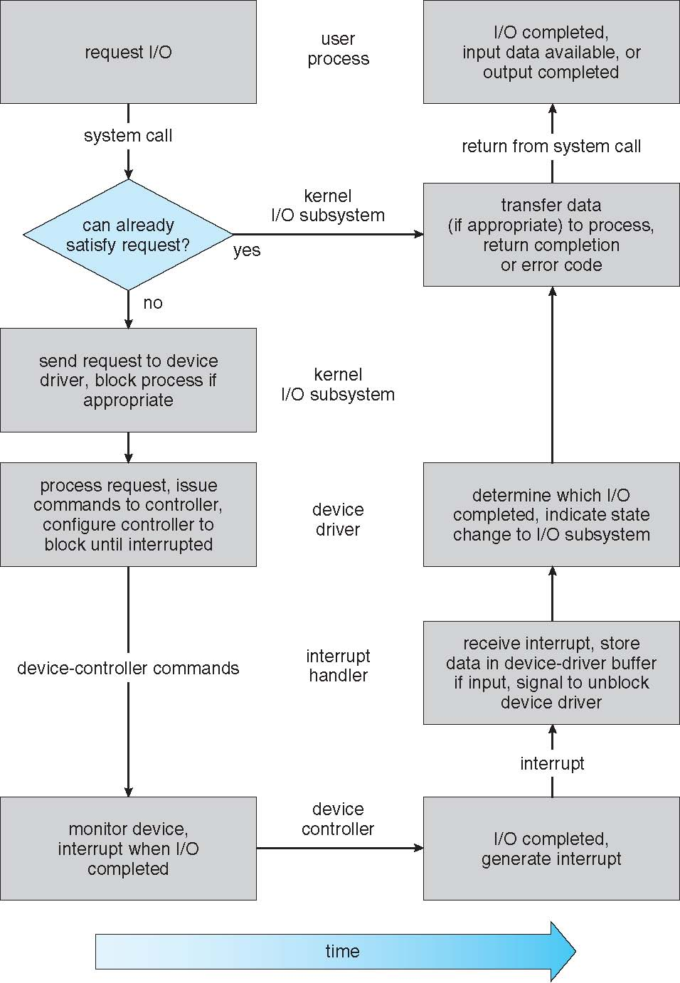
Life Cycle of An I/O Request

Slide 29
STREAMS
STREAM – a full-duplex communication channel between a user-level process and a device in Unix System V and beyond
A STREAM consists of:
  STREAM head interfaces with the user process
  driver end interfaces with the device
  zero or more STREAM modules between them
Each module contains a read queue and a write queue
Message passing is used to communicate between queues
  Flow control option to indicate available or busy

Slide 30
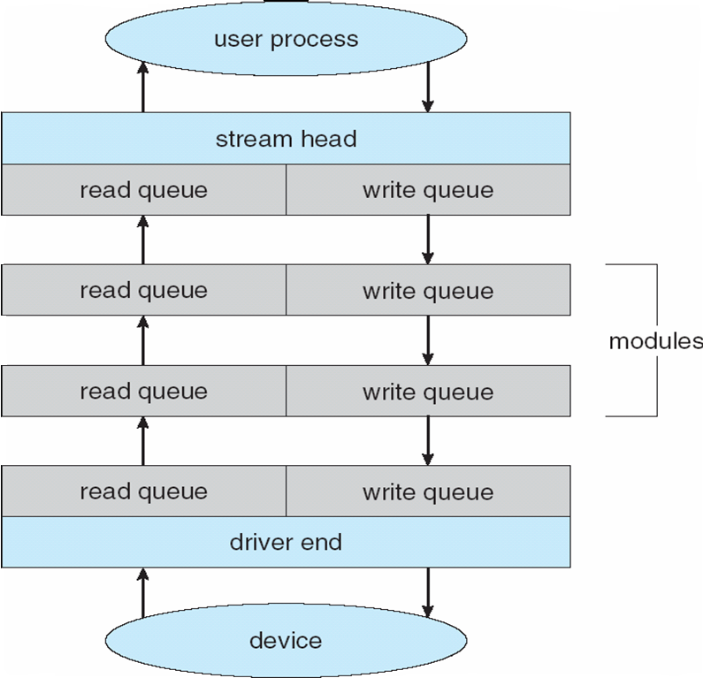
The STREAMS Structure

Slide 31
Performance
I/O a major factor in system performance:
  Demands CPU to execute device driver, kernel I/O code
  Context switches due to interrupts
  Data copying
  Network traffic especially stressful

Slide 32
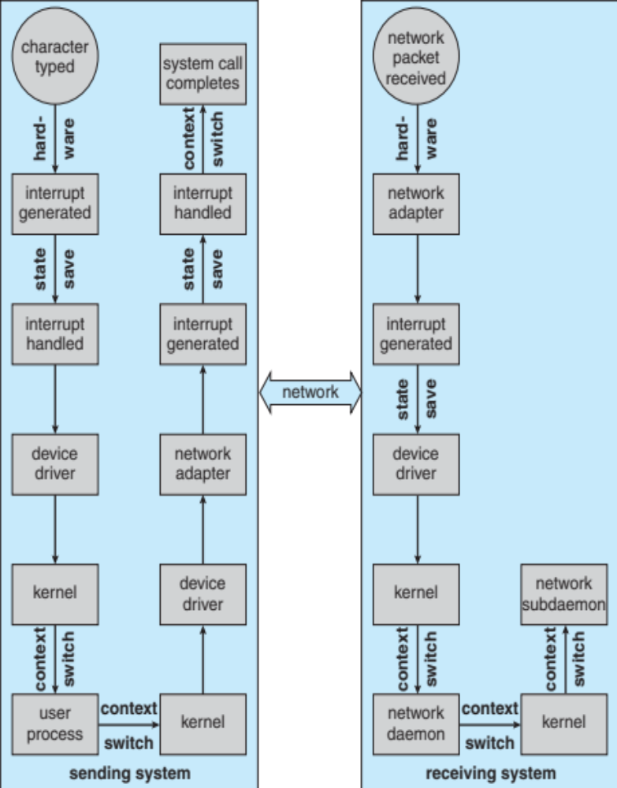
Intercomputer Communications

Slide 33
Improving Performance
Reduce number of context switches
Reduce data copying
Reduce interrupts by using large transfers, smart controllers, polling
Use DMA
Use smarter hardware devices
Balance CPU, memory, bus, and I/O performance for highest throughput
Move user-mode processes / daemons to kernel threads

Slide 34
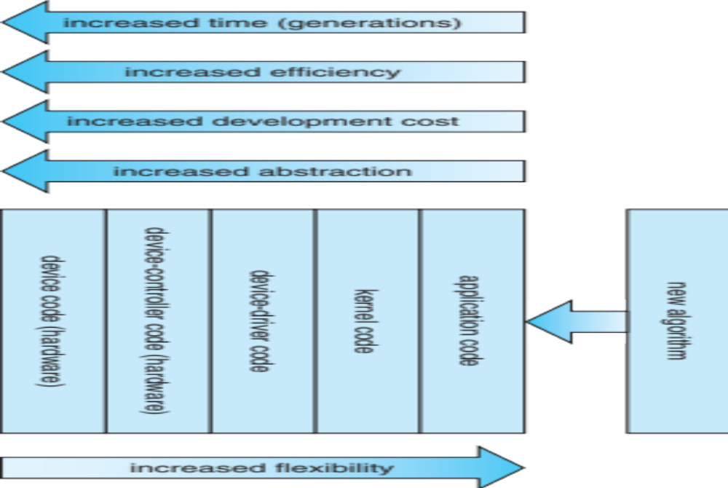
Device-Functionality Progression

